Slide 1
Historical Foundations of Education By: Janice B. Theie
Chapter 10
Education from the Depression to the War on Poverty (1930-1960)
Catherine (Dee) Moore
EDUC 6315

Slide 2
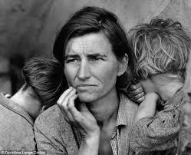
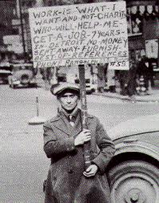
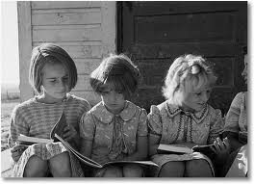
Focus Event
Imagine that you are a parent of four children living during The Great Depression. The stock market crashed and you just lost your job. Your children’s school and many others had to close because of lack of funds to keep them running. What do you do?

Slide 3
Great Impacts on schools and Education
Schools/education suffer – Great Depression
Efforts to reform school system – business sector vs teachers
WWII – prohibited discrimination in the work place (President Roosevelt)
Effects on Math and Science Curricula (from the war)
Struggle for teachers / poor conditions for teachers
Physics in schools (Sputnik)
Increased emphasis on school desegregation (Brown vs. Board of Education)
Greater fed involvement in schools
Rise of Progressive Education Movement

Slide 4
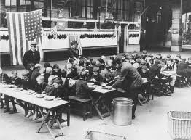
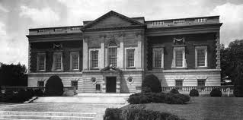
Knowledge-Based Question
What effects did the Great Depression have on education?
Spend about a minute discussing with a partner and be ready to share.
Answers on pages 223-224

Slide 5
Knowledge-Based Answer
School funding (allotting the money to rural versus wealthier area schools)
Schools closing or shortened school year
Low teacher pay or losing job altogether
Suffering/ lack of faith in economic leaders
New Deal programs (President Franklin D. Roosevelt)
Business sector gets involved
George S. Counts declares war on capitalism

Slide 6
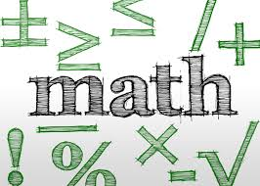
Comprehension-Based Question
Describe in your own words why Science & Math education were under such scrutiny after WWII.
Spend 2-3 minutes discussing your thoughts with a neighbor, and be ready to share.
Answers on pages 224-226

Slide 7
Comprehension-Based Answer
B/c science had been so important in the war, the teaching of it in the U.S. needed to be the best in the world
Scientific method should be taught so the ordinary person would understand it is used in everyday life/rather than be looked at as something to be feared
Math was said to have been poorly taught
Physics curriculum had been updated slower than any other curriculum in high schools at the time
Teachers were under familiar with classroom materials/equipment
Curricula was not at the level it should be (of higher level students)
Inadequate teacher training, scarcity of teachers & lack of resources

Slide 8
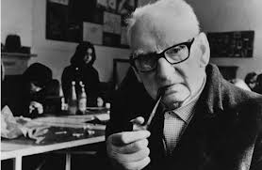
A.S. Neill
A Scottish educator that ran the English Summerhill alternative school
Believed in the “progressive education” idea – refer to chart on page 233

Slide 9
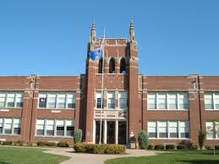
Application-Based Question
What do you think schools would be like today if they were still run under the “Progressive Movement” or according to how A.S. Neill best saw fit?
Spend about 2-3 minutes discussing your answers with a buddy, and be ready to share.
Answers on pages 232-233

Slide 10
Application-Based Answer
Answers will vary
Many students would not be prepared for college and/or the work force
Lack of structure/organization
Chaos
Problems resulting from students not educated on safe sex practices (unwanted pregnancies, diseases, etc)

Slide 11
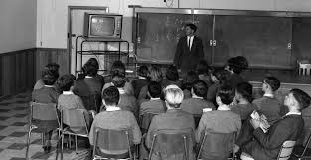
Analysis-Based Question
How would you compare public education during the 1930s-1960s to Education today?
Spend 2-3 minutes discussing with a partner, and be ready to share your thoughts with the class.
Answers on pages 235-237

Slide 12
Analysis-Based Answer
1930-1960 | Today
Schools were segregated until Brown v. Board of Education in 1954 made school segregation illegal | Schools desegregated by law, but de facto segregation still exists in some places
Progressive education movement criticized for student misbehavior & poor student academic performance | Standards set by state & national level that define standards to be mastered and acceptable performance levels of students
Great financial hardships during Great Depression caused schools to close or shorten terms | Financial problems still exist at the state and national level (not to the same magnitude, but there are still issues today)
After WWII, schools scrutinized for poorly teaching math & science | U.S. still scrutinized for low math & science scores compared to other countries (still a shortage of math and science teachers)

Slide 13
Synthesis-Based Question
Based on the issue of math and science education still being problematic today, what would you propose to help better the situation? Do you think there is a more effective way to attract math and science teachers to in turn better the situation of low scores and struggling students?
Spend 2-3 minutes discussing your thoughts with someone around you, and be ready to share with the class.

Slide 14
Synthesis-Based Answer
Answers will vary depending on personal experience and opinion

Slide 15
Evaluation-Based Question
What do you believe is the most important educational contribution from the 1930s – 1960s?
Spend 2-3 minutes discussing your thoughts with a neighbor, and be ready to share with the class.

Slide 16
Evaluation-Based Answer
Answers will vary, but some ideas might include:
School desegregation/civil rights
The importance of math and science education
Etc…..

Slide 17
Closure Trivia!!!
Question 1: What Supreme Court case in 1954 declared that separate public schools for white and black students was unconstitutional?
Answer: Brown vs. Board of Education
Question 2: What was the name of the first satellite launched into space by
The Soviet Union in the 1950s that prompted the US to focus more on math and science in schools?
Answer: Sputnik
Question 3: What was the name of the educator who was an advocate of the “alternative/progressive movement” and whose educational philosophy was scrutinized by many?
Answer: A.S. Neill

Slide 18
Sources
Historical Foundations of Education, by: Janice B. Theie
https://www.google.com/search?q=a.s.+neill&hl=en&source=lnms&tbm=isch&sa=X&ei=wuVeUZ65H8OlqgHNwoGYBw&sqi=2&ved=0CAcQ_AUoAQ&biw=1024&bih=628
http://www.google.com/search?hl=en&gs_rn=8&gs_ri=psy-ab&cp=13&gs_id=1q&xhr=t&q=what+is+sputnik&biw=1366&bih=628&bav=on.2,or.r_qf.&bvm=bv.44770516,d.b2I&wrapid=tljp1365275065998030&um=1&ie=UTF-8&tbm=isch&source=og&sa=N&tab=wi&ei=y3FgUZbjEeOz2QXck4C4Dw#um=1&hl=en&tbm=isch&sa=1&q=great+depression&oq=great+depression&gs_l=img.3..0l10.2005.4569.0.4878.16.8.0.8.8.0.117.577.7j1.8.0...0.0...1c.1.8.img.8E8gA6KqHhg&bav=on.2,or.r_qf.&bvm=bv.44770516,d.b2I&fp=d685bf2bd76b56cc&biw=1366&bih=628
http://www.google.com/search?hl=en&gs_rn=8&gs_ri=psy-ab&cp=13&gs_id=1q&xhr=t&q=what+is+sputnik&biw=1366&bih=628&bav=on.2,or.r_qf.&bvm=bv.44770516,d.b2I&wrapid=tljp1365275065998030&um=1&ie=UTF-8&tbm=isch&source=og&sa=N&tab=wi&ei=y3FgUZbjEeOz2QXck4C4Dw#um=1&hl=en&tbm=isch&sa=1&q=schools+during+the+great+depression&oq=schools+during+the+great+depression&gs_l=img.3..0.161236.162756.4.163662.7.7.0.0.0.0.80.348.7.7.0...0.0...1c.1.8.img.aOCFsWs-7ms&bav=on.2,or.r_qf.&bvm=bv.44770516,d.b2I&fp=d685bf2bd76b56cc&biw=1366&bih=628
https://www.google.com/search?hl=en&site=imghp&tbm=isch&source=hp&biw=1024&bih=628&q=progressive+schools&oq=progressive+schools&gs_l=img.3..0l3j0i24l7.1036.3806.0.3955.19.18.0.1.1.0.117.1162.16j2.18.0...0.0...1ac.1.8.img.NrOS6cLot1I#hl=en&site=imghp&tbm=isch&sa=1&q=school&oq=school&gs_l=img.3..0l10.30319.30963.0.31128.6.4.0.2.2.0.91.243.4.4.0...0.0...1c.1.8.img.Hx72GNxvzfU&bav=on.2,or.r_cp.r_qf.&bvm=bv.44990110,d.b2I&fp=6a564f17edd89819&biw=1024&bih=628
https://www.google.com/search?hl=en&site=imghp&tbm=isch&sa=1&q=public+education+in+the+1950s&oq=public+education+in+the+1950s&gs_l=img.3..0i24.903004.910554.2.910931.29.17.0.12.12.0.190.1195.15j2.17.0...0.0...1c.1.8.img.N8TzeYkraBI&biw=1024&bih=628&cad=cbv&sei=jilkUZX_KYiV8AHF8oHICw
https://www.google.com/search?hl=en&site=imghp&tbm=isch&sa=1&q=public+education+in+the+1950s&oq=public+education+in+the+1950s&gs_l=img.3..0i24.903004.910554.2.910931.29.17.0.12.12.0.190.1195.15j2.17.0...0.0...1c.1.8.img.N8TzeYkraBI&biw=1024&bih=628&cad=cbv&sei=jilkUZX_KYiV8AHF8oHICw#hl=en&site=imghp&tbm=isch&sa=1&q=public+education+today&oq=public+education+today&gs_l=img.3..0i24.85593.86125.0.86418.5.3.0.2.2.0.116.253.2j1.3.0...0.0...1c.1.8.img.eT42hayE-fg&bav=on.2,or.r_qf.&bvm=bv.44990110,d.b2U&fp=694026acb8dd10cd&biw=1024&bih=628
https://www.google.com/search?hl=en&site=imghp&tbm=isch&sa=1&q=public+education+in+the+1950s&oq=public+education+in+the+1950s&gs_l=img.3..0i24.903004.910554.2.910931.29.17.0.12.12.0.190.1195.15j2.17.0...0.0...1c.1.8.img.N8TzeYkraBI&biw=1024&bih=628&cad=cbv&sei=jilkUZX_KYiV8AHF8oHICw#hl=en&site=imghp&tbm=isch&sa=1&q=teaching+math+and+science&oq=teaching+math+and+science&gs_l=img.3..0i24l5.132331.135935.2.136102.25.16.0.9.9.1.122.932.15j1.16.0...0.0...1c.1.8.img.yRGHCdNmWC4&bav=on.2,or.r_qf.&bvm=bv.44990110,d.b2U&fp=694026acb8dd10cd&biw=1024&bih=628
https://www.google.com/search?hl=en&site=imghp&tbm=isch&sa=1&q=public+education+in+the+1950s&oq=public+education+in+the+1950s&gs_l=img.3..0i24.903004.910554.2.910931.29.17.0.12.12.0.190.1195.15j2.17.0...0.0...1c.1.8.img.N8TzeYkraBI&biw=1024&bih=628&cad=cbv&sei=jilkUZX_KYiV8AHF8oHICw#hl=en&site=imghp&tbm=isch&sa=1&q=education&oq=education&gs_l=img.3..0l10.24365.25582.6.25780.9.5.0.4.4.0.123.331.4j1.5.0...0.0...1c.1.8.img.5bGf6WD8dAw&bav=on.2,or.r_qf.&bvm=bv.44990110,d.b2U&fp=694026acb8dd10cd&biw=1024&bih=628

